Slide 1


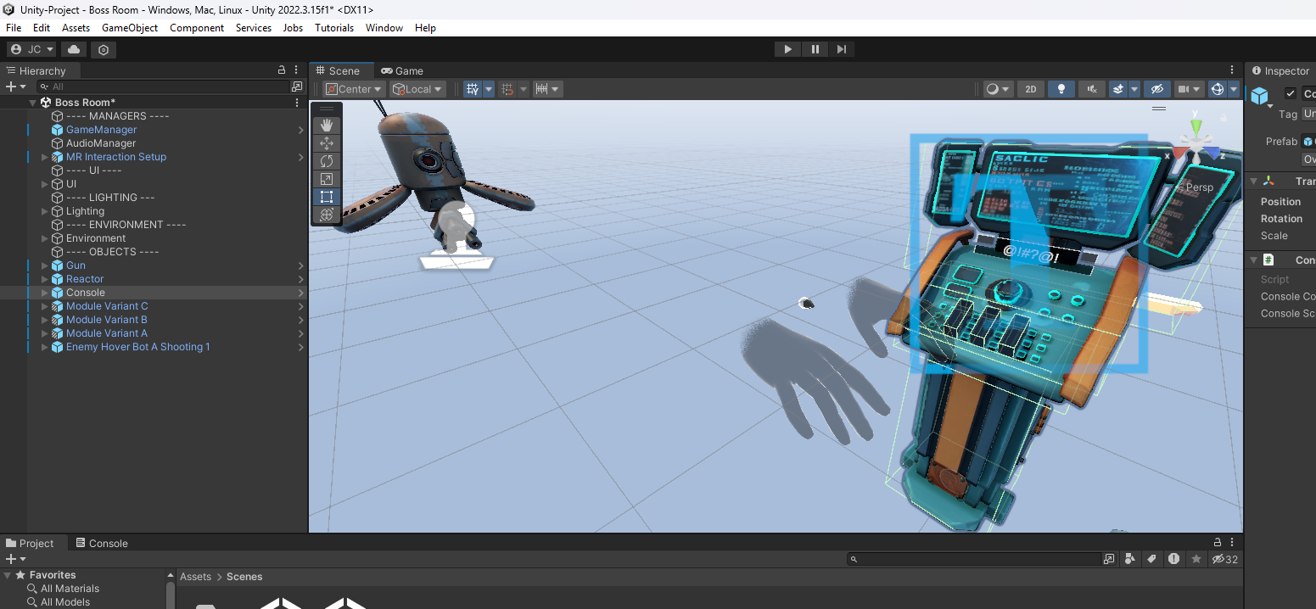

Virtual Reality
Wednesdays at 6:00pm
CIST 1423 - 2010 VIRTUAL REALITY PROGRAMMING AND TECHNOLOGY
PS: student presentation at 6:00, then we head out for Panther pics

Slide 2
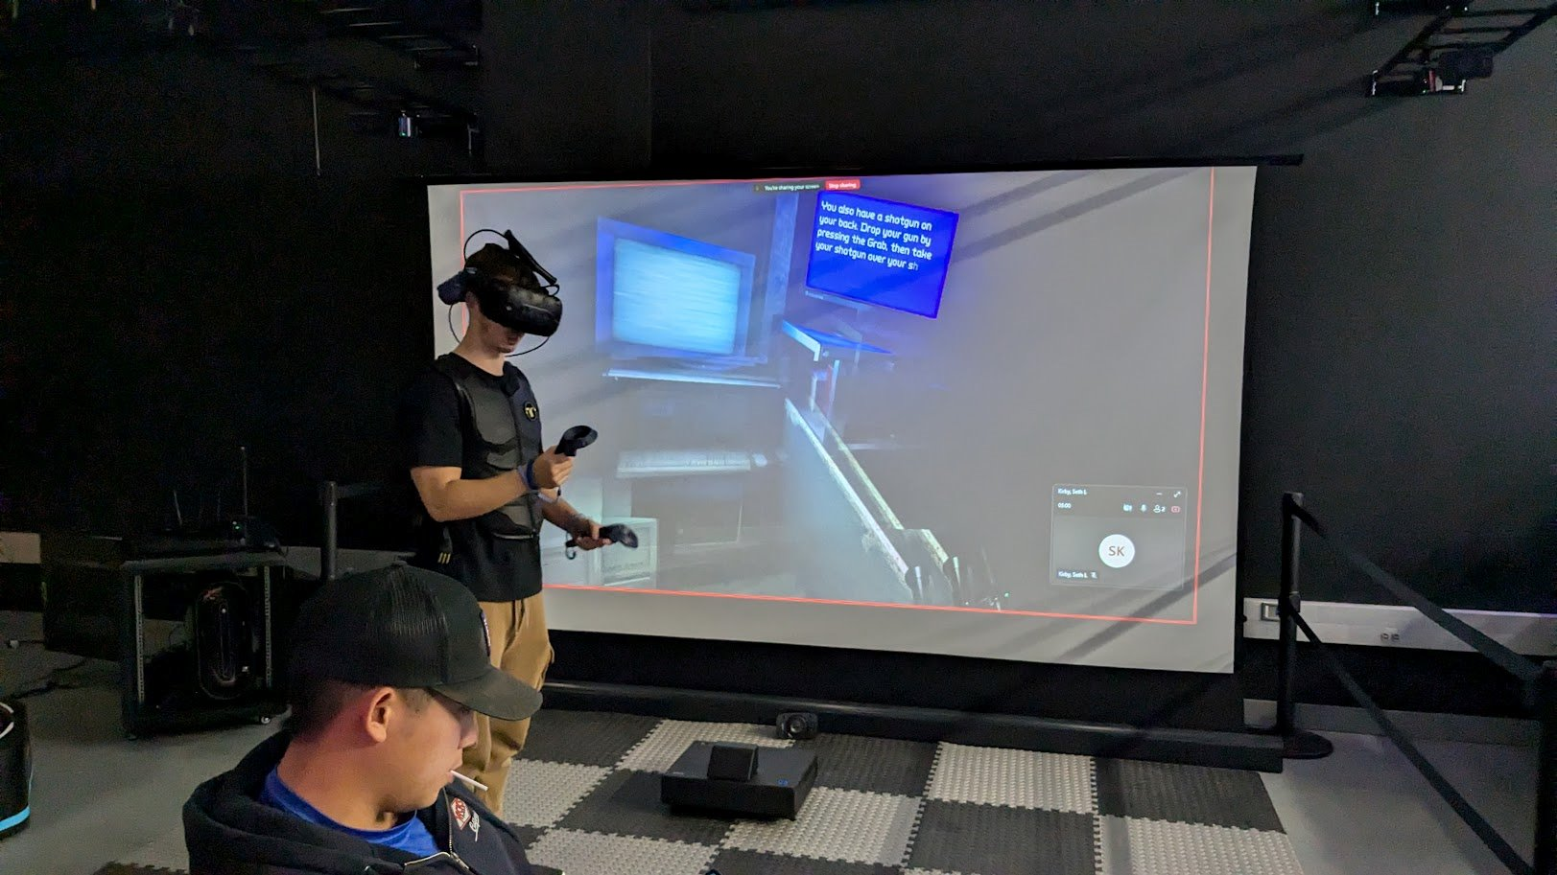
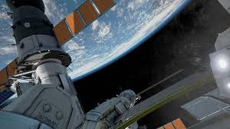
Agenda
Unity + Fishing Sim
Events
Panther Model

Slide 3


No class next week – party instead!
Wednesday, September 9 2026
5:00pm – 8:00pm

Slide 4


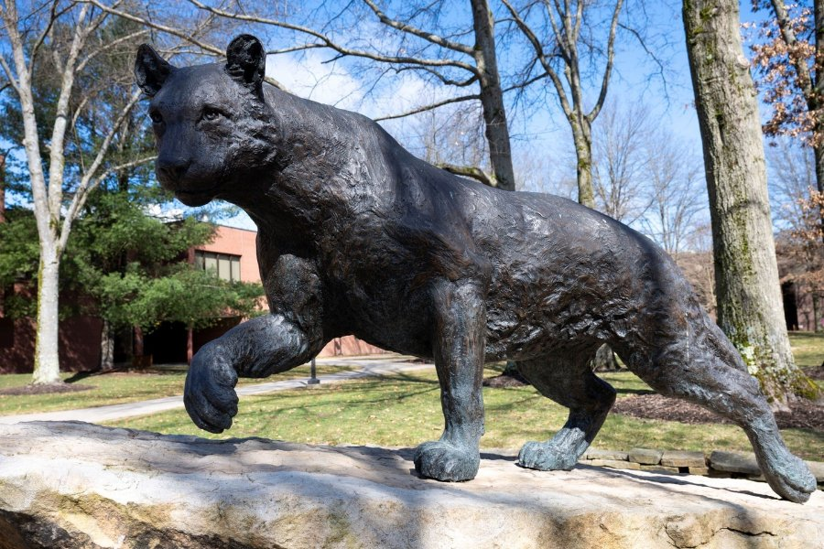
Right now: Panther Model Pics
~6:15–6:30 PM — right after the student presentation
The subject: the bronze Panther
Shot details
100–150 photos, 60–70% overlap between shots
Circle the statue at 3 heights: low, eye-level, high (step-stool/phone-up)
Overcast light or open shade — avoid hard shadows and glare on the bronze
Keep people and moving objects out of frame; steady hands, no motion blur
A few close-up detail shots of the face/paws for texture quality
CIST 1423 — Week 2

Slide 5



After the shoot: what to do with the photos
Upload immediately
Make your own folder
Nothing gets deleted
Everyone uploads their shots into the shared "Panther-Shoot-Wk2" folder on the class OneDrive folder- Panther-Shoot-Wk2
Keep each person’s photos in their own subfolder (initials + count, e.g. "JC_38") so we can tell which set is missing angles.
Keep originals even if a shot looks bad or blurry — the photogrammetry tool decides what’s usable..
CIST 1423 — Week 2

Slide 6
Last week → this week
Week 1 recap
This week: Ch. 2 (first half)
GitHub + Unity Hub accounts created
Toured the Vive Pro 2, Quest 2/3, HoloLens stage
SteamVR interaction sample explored
Choosing a render pipeline (URP)
Touring the Editor: Hierarchy, Scene, Game, Inspector, Project
Working with merging FIshing Sim + VRPsych Example:
https://github.com/jcallinan/CIST1423-Fall2026-Examples/blob/master/Week-02-PantherCamCast/README.md
https://github.com/jcallinan/VRPsych2024
CIST 1423 — Week 2

Slide 7



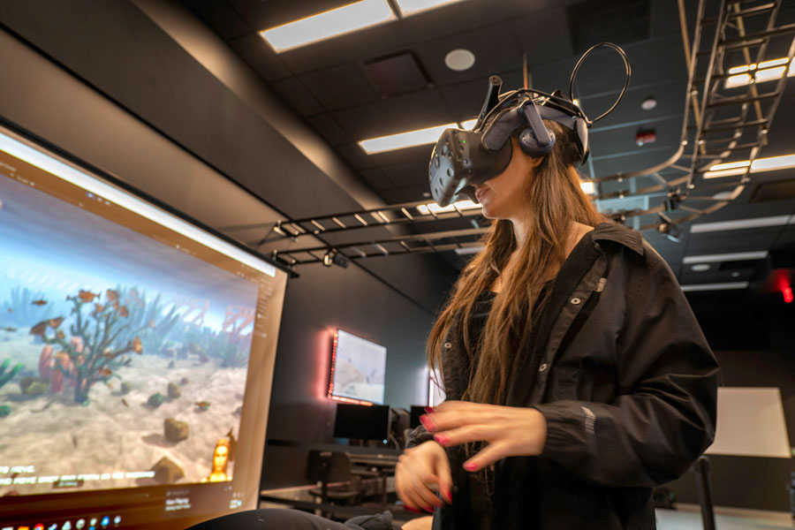
The Unity Editor, piece by piece
Hierarchy
Scene & Game view
Inspector
Project window
Every GameObject in the open scene, nested by parent/child
Scene = you moving around; Game = what the player/headset sees
Components + values on whatever you’ve selected
Every asset in the project, on disk
CIST 1423 — Week 2

Slide 8
Photos → 3D model → Unity
1. Capture
2. Process
3. Clean & decimate
4. Import to Unity
KIRI Engine
Polycam
Meshroom
RealityScan
Free mobile app, phone-only workflow, Photo Scan mode
Free tier, LiDAR + photo mode, fast cloud processing
Open-source (AliceVision), desktop, node-based, full control
Free (Epic Games), high-quality output, exports for Unity
kiriengine.app
poly.cam/tools/photogrammetry
github.com/alicevision/Meshroom
https://www.realityscan.com/download
CIST 1423 — Week 2

Slide 9




Resources & links: 3d scanning
WATCH
READ
Phone photogrammetry, start to finish https://www.youtube.com/watch?v=45D0pFdqVgw
KIRI Engine Photo Scan tutorial https://www.kiriengine.app/tutorial/introduction-to-photo-scan
Polycam photogrammetry tool https://poly.cam/tools/photogrammetry
Juicy fishing minigame, step by step https://www.youtube.com/watch?v=EzppT0YhOzg
Alumni & Family Weekend 2026 schedule https://www.upb.pitt.edu/student-engagement/alumni-and-family-weekend
VR World Tour demo reference (2025) https://www.youtube.com/watch?v=6Xw-4Yu2ijA
CODE
Meshroom (open-source photogrammetry) https://github.com/alicevision/Meshroom
Our course repos
Unity fishing minigame sample package https://github.com/evskii/UnityFishingMinigame
CIST1423 weekly examples (this repo) https://github.com/jcallinan/CIST1423-Fall2026-Examples
CIST1422 weekly examples (game-design side) https://github.com/jcallinan/CIST1422-Fall2026-Examples
VR fishing simulator (reference project) https://github.com/NovoZZZ/fishing_simulator
Rhodium — Destiny Clone https://github.com/jcallinan/Rhodium
CIST 1423 — Week 2

Slide 10



Not starting from zero: reusing SaintTropez
VRPsych2024 project already has most of what a fishing sim needs, we can export a scene from it, to import to a new project:
Water surface
Swimming fish
Dock model
Bobber physics
NVJOB Water Shaders V2 — a working URP water material, ready to drop under the dock
Fish Schools pack (Amberjack, Bass, Goldfish, Koi, Salmon) driven by #NVJOB Boids flocking
Pier-House 3 — an actual dock/pier prefab, which is exactly our "walk the dock" opener
NWH Dynamic Water Physics 2 — buoyancy we can reuse for a floating bobber, not code from scratch
Target: SteamVR first
We’re building for SteamVR + the Vive Pro 2 first, because that’s what runs on stage — the project already has SteamVR, SteamVR_Input, and a working VRInteractions system wired in. Other headsets (Quest, etc.) can come later once the core loop works.
CIST 1423 — Week 2

Slide 11




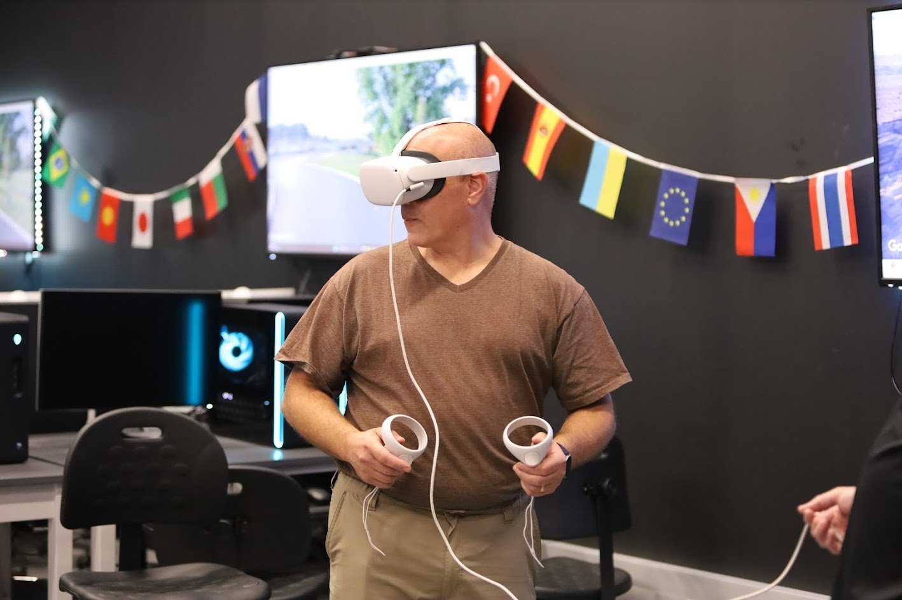
Final product: a fishing simulator
Walk the dock
Cast
Wait & bite
Reel it in
Catch & display
Player approaches the pond on the reused Pier-House dock, Panther statue overlooking the water
SteamVR trigger-pull cast — physical rod motion, grabbed via the Interaction System
Bobber (Dynamic Water Physics buoyancy) dips; haptic pulse and audio cue signal a bite
Timing/tension minigame, driven by the SteamVR trigger — reel too fast and the line snaps
Fish added to a trophy case beside the Panther model
https://github.com/jcallinan/CIST1423-Fall2026-Examples/tree/master/Week-02-PantherCamCast
Note: we may want to use another method - https://assetstore.unity.com/search#q=fishing
CIST 1423 — Week 2

Slide 12


The Player rig, and why SteamVR Input is action-based
The Player prefab
Actions, not raw buttons
A singleton (Player.instance) that owns the camera rig and both Hand objects — this is what you drag into every scene instead of a bare Main Camera
Each Hand already carries SteamVR Input action bindings, plus a fallback 2D keyboard/mouse mode for testing without a headset on
Exposes hmdTransform, feetPositionGuess, and bodyDirectionGuess — useful for anything that needs to know roughly where the player is standing (e.g., "have they walked out onto the dock yet?")
You define what the game needs — "Grab," "Cast," "Reel" — once, in an actions.json manifest (built with the SteamVR Input window in Unity)
SteamVR auto-generates a SteamVR_Actions class, so code reads SteamVR_Actions.default_Grab instead of a hard-coded Vive/Index/Quest button
The player (or SteamVR’s binding UI) maps each action to whatever controller is actually plugged in — swap Vive wands for Index knuckles and the code never changes
CIST 1423 — Week 2 — SteamVR Interaction System & Input

Slide 13
Reading actions: booleans, axes, and poses
Three action types cover almost everything a fishing rod needs — a button press, a 2D reel/tension axis, and the controller’s own tracked pose.
void Update() {
// Boolean action — did the grip fire this frame?
if (SteamVR_Actions.default_GrabGrip
.GetStateDown(hand.handType)) {
TryGrabRod();
}
// Vector2 action — trackpad/thumbstick, e.g. reel tension
Vector2 axis = SteamVR_Actions.default_Reel
.GetAxis(hand.handType);
}
Event-driven alternative
AddOnStateDownListener(callback, handType) fires once, the instant the button goes down — no polling in Update()
Same idea as a C# event/UnityEvent — good fit for "cast" and "release" moments; polling GetAxis() fits continuous values like reel speed better
SteamVR_Input_Sources.LeftHand / RightHand / Any — pass hand.handType so the same script works on either controller
CIST 1423 — Week 2 — SteamVR Interaction System & Input

Slide 14
Making the rod grabbable: Interactable + Throwable
Two components from the Interaction System, dropped onto the FishingRod prefab, do most of the work.
Interactable
Throwable
A marker component — it identifies the rod to a Hand as something that can be hovered and picked up. No behavior of its own; other scripts (and the Hand itself) check for it.
Handles the actual pickup/release: attaches on grab, follows the hand while held, and on release hands the object the controller’s real-world velocity (via a VelocityEstimator) so a thrown object flies naturally.
The Hand message lifecycle — implement any of these on the rod script
OnHandHoverBegin(Hand) → HandHoverUpdate(Hand) every frame in range → OnAttachedToHand(Hand) on grab → HandAttachedUpdate(Hand) every frame while held → OnDetachedFromHand(Hand) on release
CIST 1423 — Week 2 — SteamVR Interaction System & Input

Slide 15
Casting: reading the controller’s real swing
Throwable already knows how to let go of the rod itself — casting the lure is a second, smaller problem: read the hand’s tracked velocity at the moment of release.
// On the Hand’s SteamVR_Behaviour_Pose component
Vector3 vel = pose.GetVelocity();
Vector3 angVel = pose.GetAngularVelocity();
if (SteamVR_Actions.default_Cast.GetStateUp(hand.handType)) {
if (vel.magnitude > castThreshold) {
lureRigidbody.velocity = vel * castPowerMult;
lureRigidbody.isKinematic = false;
StartCasting(); // → FishState.casting
}
}
How this works
GetVelocity()/GetAngularVelocity() come straight from the tracked controller pose — the same data VelocityEstimator uses for a thrown object
GetStateUp() mirrors GetStateDown() — true on the one frame a button is released, which is exactly "let the lure fly"
This is the same real-swing feel Beat Saber-style games use — no canned animation, the player’s own arm motion drives it
CIST 1423 — Week 2 — SteamVR Interaction System & Input

Slide 16

The bobber: buoyancy we already own, plus a bite event
Floating for free
BiteController.cs (ours to write)
The lure lands, isKinematic goes false, and NWH Dynamic Water Physics 2 (already in SaintTropez) takes over — it applies buoyancy to any Rigidbody that enters its water volume
No custom float code needed for Week 2 — the asset is the same one under Pier-House’s existing water, just pointed at a new object
IEnumerator WaitForBite() {
yield return new WaitForSeconds(
Random.Range(minWait, maxWait));
isBiting = true;
SteamVR_Actions.default_Haptic.Execute(
0, 0.5f, 4, 0.6f, hand.handType);
}
CIST 1423 — Week 2 — SteamVR Interaction System & Input

Slide 17
The reel: tension, and a FishState Enum
Same pattern CIST 1422 is using for Mission Demolition’s GameMode — a small Enum keeps "what’s happening right now" typo-proof and easy to read.
public enum FishState {
idle, aiming, cast, waiting, biting, reeling, caught
}
public FishState state = FishState.idle;
void Update() {
if (state != FishState.reeling) return;
Vector2 reel = SteamVR_Actions.default_Reel
.GetAxis(hand.handType);
tension += reel.y * reelSpeed * Time.deltaTime;
if (tension > snapThreshold) LineSnapped();
else if (progress >= 1f) state = FishState.caught;
}
Why an Enum here too
Every step (Approach → Cast → Wait → Bite → Reel → Catch) is exactly one FishState — the UI and animation both just ask "what state are we in?"
Reel too hard (tension) and the line snaps — same "fail state" feeling as missing an Apple in Apple Picker
GetAxis(hand.handType).y drives progress continuously — no per-frame button mashing required
CIST 1423 — Week 2 — SteamVR Interaction System & Input

Slide 18
Catch it, show it off, and where to start building
The catch
Suggested build order
FishState.caught disables the lure’s Collider, plays a catch VFX/SFX, and Instantiates a trophy prefab at a display stand beside the Panther model
Same GameObject/prefab pattern as everything else this semester — no new concepts, just applying Instantiate() again
1. Player rig in the scene, hands can hover/grab a placeholder cube
2. Interactable + Throwable on the real rod model
3. Cast via GetVelocity(), lure floats on Dynamic Water Physics
4. BiteController + haptic pulse
5. FishState + reel tension loop
6. Catch, trophy case, polish

Slide 19




CIST 1422 · GAME DESIGN & PROGRAMMING
Resources & links: fishing sim
WATCH
CONTEXT
Juicy fishing minigame, step by step https://www.youtube.com/watch?v=EzppT0YhOzg
Alumni & Family Weekend 2026 schedule https://www.upb.pitt.edu/student-engagement/alumni-and-family-weekend
Phone photogrammetry, start to finish https://www.youtube.com/watch?v=45D0pFdqVgw
CODE
Our GitHub repos
Unity fishing minigame sample package https://github.com/evskii/UnityFishingMinigame
CIST1422 examples (this repo) https://github.com/jcallinan/CIST1422-Fall2026-Examples
Small fishing game, practice-scale https://github.com/Ithalos/FishingGame
Week 2 starter: Hello World + a fishing-mechanics stub, up after class.
VR fishing simulator (reference project) https://github.com/NovoZZZ/fishing_simulator
CIST1423 examples (VR side) https://github.com/jcallinan/CIST1423-Fall2026-Examples
Weekly VR examples — worth a look for the scan pipeline & SteamVR setup.
Rhodium (shared capstone) https://github.com/jcallinan/Rhodium
Not weekly-mapped, but shared across both courses — worth a look.
CIST 1422 — Week 2

Slide 20

CIST 1422 · GAME DESIGN & PROGRAMMING
More resources: building the fishing loop
WATCH
Finite state machines for game AI (Unity) https://www.youtube.com/watch?v=cwlFbLLR3qc
Already in SaintTropez (VRPsych2024)
How to set up the SteamVR plugin in Unity https://www.youtube.com/watch?v=hMkfsiX2JiU
Water Shaders V2 — the pond surface
Fish Schools (5 species), boid-driven AI
Pier-House dock model to walk out on
Dynamic Water Physics 2 — bobber buoyancy
SteamVR + Interaction System — already wired in
CODE
SteamVR Unity Plugin (official, Valve) https://github.com/ValveSoftware/steamvr_unity_plugin
NVJOB Boids — source of our fish-schooling asset https://github.com/nvjob/nvjob-boids
READ
C# state machine pattern (game AI) https://gamedevbeginner.com/state-machines-in-unity-how-and-when-to-use-them/
SteamVR Interaction System docs (grab, throw, hints) https://valvesoftware.github.io/steamvr_unity_plugin/articles/Interaction-System.html
CIST 1422 — Week 2

Slide 21

More resources: SteamVR & the fishing sim
WATCH
How to set up the SteamVR plugin in Unity https://www.youtube.com/watch?v=hMkfsiX2JiU
Already in SaintTropez (VRPsych2024)
VR fishing simulator, concept walkthrough https://www.youtube.com/watch?v=Oohjh-JC020
#NVJOB Water Shaders V2 — water surface material
Fish Schools — 5 species, boid-driven swimming
Pier-House 3 — dock/pier model for the walk-out
NWH Dynamic Water Physics 2 — buoyancy for the bobber
SteamVR + SteamVR_Input + VRInteractions — already wired in
CODE
SteamVR Unity Plugin (official, Valve) https://github.com/ValveSoftware/steamvr_unity_plugin
NVJOB Boids — source of our fish-schooling asset https://github.com/nvjob/nvjob-boids
READ
SteamVR Interaction System docs (grab, throw, hints) https://valvesoftware.github.io/steamvr_unity_plugin/articles/Interaction-System.html
VR grabbing tutorial (SteamVR 2.0) https://wirewhiz.com/vr-grabbing-tutorial/
CIST 1423 — Week 2

Slide 22

Next steps – homework + planning

